Slide 1
Clearance Processing Updates
FISWG
12 July 2017
Wanda Walls
Security Representative Asc Mgr
Steven Burke
Facility Security Officer, Corporate HQ

Slide 2
Agenda
PSMO Backlog History and Path Forward
Interim Determination Timelines
Investigation Timelines
DISS Overview
The New SF86 and eApplication
SEAD 3 & 4 Update
JPAS Overview
JPAS Access
JPAS Basics

Slide 3
Why is it taking so long to get an interim clearance?
Why is there such a huge backlog?
How does moving PRs to 6 years help?

Slide 4
PSMO-I Backlog History
Jan 2016 - July 2016: To stay within its budget, DSS began metering expenditures of PSI-I funds and maintaining a daily limit on cases submitted to the Office of Personnel Management (OPM).
Significant delays in processing
Increased inventory
By July of 2016, the PSI backlog was over 524,000 cases
The Service Secretaries express concern to the Secretary of Defense regarding the PSI backlog in a jointly signed memo
Additional funding received through reprogramming approved by Congress

Slide 5
PSMO-I Path Forward
Tier 5 PR periodicity extended to 6 years, allowing for inventory to fall under the next fiscal year
All TSPRs have ceased with the exception of Presidential, NATO, and Reliability programs
Tier 3 PR for SAP Programs extended to 6 years, but have remained within the 5 year timeline
The 6 year timeline will be reevaluated at the end of the year
Closed the Knowledge Center for 2.5 weeks
Interim decisions timelines have already begun to decline

Slide 6
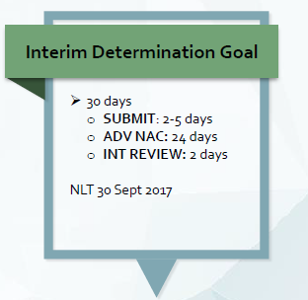
Interim Determination Timelines
Interim determinations went from 3-5 days to 3-4 months
Factors driving up timelines were the backlog and a change in DoD policy requiring an Advanced NAC before they will grant an interim determination.
Favorable review of the SF-86
Favorable review of local personnel, medical, plice, and security records as applicable
Fingerprint check
Proof of citizenship
Scheduled investigation with NBIB
Going forward, interims will take at least 30 days

Slide 7
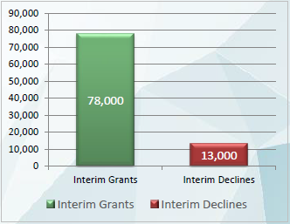
Interim Declinations
Common Interim Declination Reasons:
Financial Considerations
Foreign Preference – Passport / ID Card
Foreign Influence – Family
Drug Involvement
Alcohol Consumption

Slide 8
NBIB Timelines
As Reported in the National Security Oversight Reports Mar 30, 2017
Case Type | PSMO-I Approved | Investigate | Adjudicate | Total
Top Secret Initial | 48 | 409 | 18 | 475
Top Secret PR | 119 | 365 | 46 | 530
Secret Initial | 48 | 198 | 26 | 272
Secret PR | 115 | 115 | 18 | 248

Slide 9
e-QIP Rejections
What you can do to avoid e-QIP rejections:
Ensure e-QIP is actually required
Encourage the applicant to thoroughly review the information providing detailed remarks when applicable
FSOs: conduct thorough review for completeness and accuracy prior to submission to PSMO-I
Use Click to Sign for all forms associated with the e-QIP
Submit fingerprints electronically as soon as e-QIP is submitted to PSMO-I
14 day deadline

Slide 10
New e-QIP Rejections
Some recent uncommon rejections we’ve seen:
Section 13A: Overlapping employment and unemployment
Section 16: Reference(s) provided reside overseas
Section 16: Reference(s) provided are listed elsewhere on the form
Section 17: Incomplete address for former spouse
Section 18: Unknown/Incomplete address of Relative(s)
Even when addressed in the remarks

Slide 11
Defense Information System for Security (DISS) Overview

Slide 12
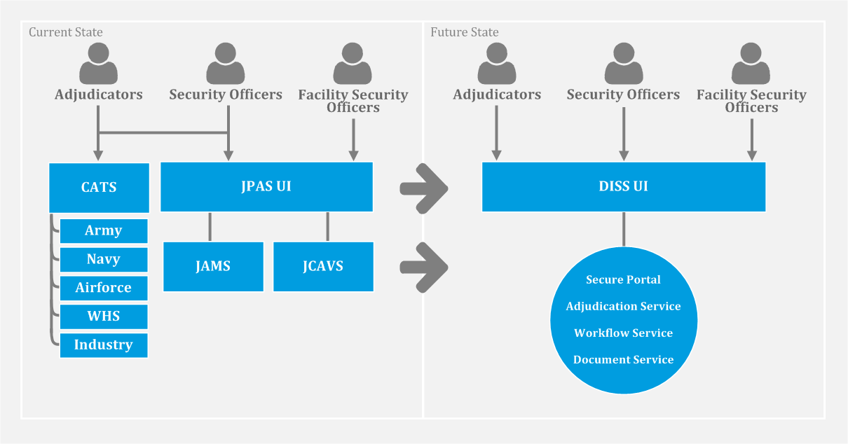
Defense Information System for Security
The Defense Information System for Security (DISS), once fully deployed, will replace the Joint Personnel Adjudication System (JPAS), to serve as the system of record to perform comprehensive personnel security, suitability and credential eligibility management for all Military, civilian, and DOD contractor personnel. DISS provides secure communications between Adjudicators, Security Officers and Component Adjudicators in support of eligibility and access management.

Slide 13
What to expect in DISS
Continuous and integrated workflow between DoD CAF, PSMO-I and FSOs
FSOs can monitor case determination actions
FSOs can submit Customer Service Request (previously an RRU) and Supplemental Information Documents through secure electronic submission
DoD CAF will submit Request for Action (previously CAF message) to FSOs
E-Adjudications) for applicable T-3 case files
FSOs can Upload SF-312s
No Lockouts when accidentally hitting the “x”
Incident Reporting:
Submit the incident and supporting documentation all at once
No more RED in JPAS

Slide 14
DISS Hierarchy Structure
DISS has a hierarchy based structure consisting of all DoD Components and cleared Facilities for user and subject management. It is referred to as the “Tree”
The waterfall structure of SMOs within the Tree is referred to as a “Branch”
Users are only capable of conducting their allowable functions within the Branches they are provisioned for
Inherent permissions are those given with the granting of the role
Optional permissions are those selected by a Hierarchy Manager or Account Manager allowing the capability to restrict additional users from conducting functions outside the scope of their responsibilities

Slide 15
Hierarchical Structure
PSMO-I
The PSMO-I can see down and take action on all SMOs below them
The parent can see down and take action on all child SMOs
Child SMOs will not be able to take actions on “sibling” SMOs
Note: Hierarchies will be established through coordination with the PSMO-I
Parent SMO
Child SMOs

Slide 16
Role Comparisons
Hierarchical Roles
Hierarchy Managers – Responsible for the SMO management throughout their Branch (creating child SMOs, editing and deactivating SOS) as well as Account Management to provision additional users.
JVS
LEVEL 2 SCI security personnel at unified command, DoD agency, military department or major command/equivalent headquarters.
LEVEL 3 SCI security personnel at echelons subordinate to Level 2 at a particular geographic location (installation, base, post, naval vessel).
LEVEL 4 Non-SCI security personnel at unified command, DoD agency, military department or major command/equivalent headquarters.
LEVEL 5 Non-SCI security personnel at echelons subordinate to Level 4 at a particular geographic location (installation, base, post, naval vessel).
LEVEL 5 Non-SCI security personnel at echelons subordinate to Level 4 at a particular geographic location (installation, base, post, naval vessel).
LEVEL 7 Non-SCI Entry control personnel. Individuals who grant access to installations, buildings, etc. Varies according to organizations.
LEVEL 8 CI Entry control personnel. Individuals who grant access to SCIF installations, buildings, etc. Varies according to organizations. (Read Access - SSBI)
LEVEL 10 Visitor Management. Level 10 users will have the same view of the JCAVS Person Summary as a JCAVS Level 7 User. They will receive Visit Notifications when their SMO is being notified of a visit. A Level 10 User may not be an Account Manager, create or delete an account at any level.
JPAS
Account Managers – Manages the users within their hierarchy by creating and maintaining user profiles, roles and permissions.
Security Managers – Functions as the manager for all subject actions within their Branch.
Non-Hierarchical Roles
Security Officer Standard – Responsible for the subject management of all personnel within their SMO.
Security Officer Administrator – Less inherent privileges than the Security Officer Standard with most capabilities only through optional permissions.
Component Adjudicator – Responsible for receiving the investigation for Suitability/HSPD-12 and making the determination if the DoD CAF is unable.
HR – Responsible for onboarding new employees which requires a view into their current eligibility and access in many cases to ensure proper vetting for contractual or mission purposes.
Security Officer Visit Support – Inherent permissions relate to visit request functionality. Optional permissions can be granted to assist a Security Officer.
Physical Access Control Personnel – Responsible for ensuring visitors have the proper access and need for entry.

Slide 17
DISS Phased Rollout
Phase 1
Migration to Single Adjudicative System
Migrate off the multiple adjudicative systems and core enterprise services into DISS
Phase 2
DISS Enterprise Subject Management
Migrate subject management capabilities and additional enterprise services into DISS. Legacy CATS/CATS Portals taken offline
Complete the rollout of the DISS enterprise services. JPAS will be taken offline during this phase.
Phase 3
Establishment of a Single System of Record

Slide 18
DISS Deployment Timeline
User Deployment:
WHS / 4th Estate
User Provisioning:
Air Force, Navy, Army,
Component Adjudicators
User Provisioning:
Industry
Dates are subject to change!
User Deployment:
Air Force, Navy,
Army Suitability
& HSPD-12
User Deployment:
PSMO-I / Industry
Turn off
Legacy CATS
JPAS Systems
Deployment/Go-Live Milestones
Operational Milestone

Slide 19
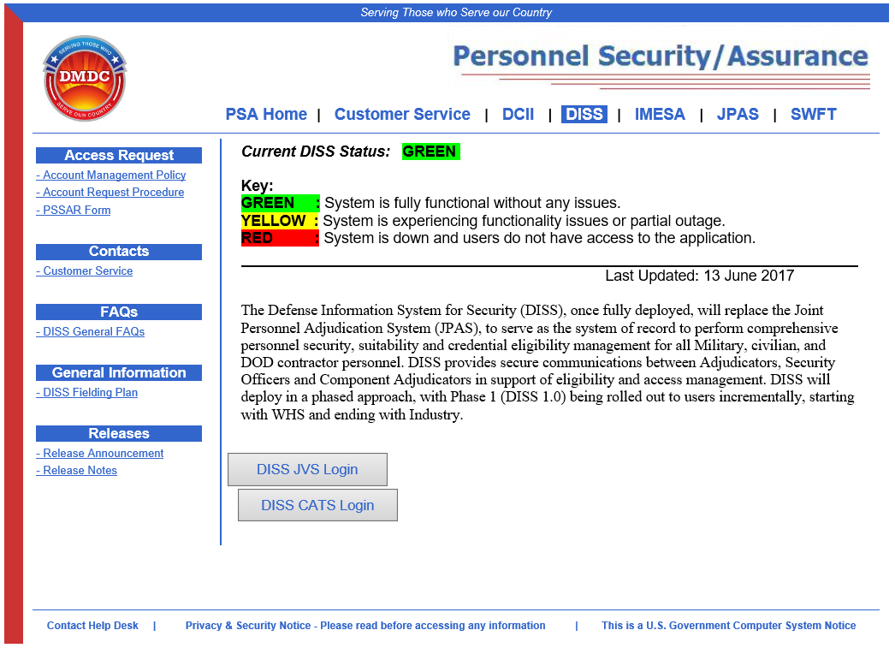
DISS Home Page
DISS Home Page URL: https://www.dmdc.osd.mil/psawebdocs/docPage.jsp?p=DISS
DISS Status, Alerts, Notices, FAQs and general information, is posted here
For Customer support:
DMDC Contact Center: 800-467-5526
DSS Call Center: 888-282-7682

Slide 20
DISS Testing and Training
Security Representatives from various organizations are actively testing JVS and meet weekly to discuss findings which are reported back to DMDC.
Recommended CDSE STEPP Training Courses
DISS Portal (EX101.16)
DISS Hierarchy Management (EX100.16)

Slide 21
New Standard Form 86 / eApplication

Slide 22
New Standard Form 86 / eApplication
New SF86 to be released late July/early August
Major changes
Mental health – the focus is shifting to more serious indicators of things like schizophrenia and personality disorders rather than general depression or anxiety; there will be several additional questions added in that section
Drug use – modifying the illegal use of drug/drug activity question to include a statement that it is illegal in accordance with Federal laws, even though permissible under state laws
New eApplication replacing eQIP to be released later this year
eApp is based on feedback from users and investigators
Unknown as to whether the current SF86 forms completed in eQIP will be brought into the new eApp system

Slide 23
Current SF-86 Section 21
In the last seven (7) years, have you consulted with a health care professional regarding an emotional or mental health condition or were you hospitalized for such a condition? Answer ‘No’ if the counseling was for any of the following reasons and was not court-ordered:
Strictly marital, family, grief not related to violence by you; or
Strictly related to adjustments from service in a military combat environment.
The current SF-86 asks one question related to mental health with no branching questions

Slide 24
New SF-86 Section 21 Changes
21A) Has a court or administrative agency EVER issued an order declaring you mentally incompetent? [Y/N]
[If No] <Navigation will proceed to Question 21B>
[If Yes] Permit multiple entries, capturing details for each entry (date, name/address of court or administrative agency)
Was this matter appealed to a higher court or administrative agency? [Y/N]
[If No] <Navigation will proceed to Question 21B>
[If Yes] Permit multiple entries, capturing details for each entry (name/address of court or administrative agency, final disposition)
Do you have any other instances where this matter was appealed to a higher court of administrative agency? [Y/N]
[If No] <Navigation will proceed to Question 21B>
[If Yes] Permit multiple entries, capturing details for each entry (name/address of court or administrative agency, final disposition)

Slide 25
New SF-86 Section 21 Changes
21B) Has a court or administrative agency EVER ordered you to consult with a mental health professional (for example, a psychiatrist, psychologist, licensed clinical social worker, etc.)? (An order to a military member by a superior officer is not within the scope of this question, and therefore would not required an affirmative response. An order by a military court would be within the scope of the question and would require an affirmative response.)[Y/N]
[If No] <Navigation will proceed to Question 21C>
[If Yes] Permit multiple entries, capturing details for each entry (date, name/address of court or administrative agency)
Was this matter appealed to a higher court or administrative agency? [Y/N]
[If No] <Navigation will proceed to Question 21C>
[If Yes] Permit multiple entries, capturing details for each entry (date, name/address of court or administrative agency)
Do you have any other instances where this matter was appealed to a higher court of administrative agency? [Y/N]
[If No] <Navigation will proceed to Question 21C>
[If Yes] Permit multiple entries, capturing details for each entry (date, name/address of court or administrative agency)

Slide 26
New SF-86 Section 21 Changes
21C) Have you EVER been hospitalized for a mental health condition? [Y/N]
[If No] <Navigation will proceed to Question 21D>
[If Yes] Permit multiple entries, capturing the details for each entry [Was admission voluntary (provide explanation) or involuntary (provide explanation)? Dates of treatment (From Date [Estimated] to Date [Estimated/Present]? Name/address of facility where treatment was provided.)
21D) Note: “The following question asks whether you have been diagnosed with a specified mental health condition that may, particularly if untreated, impact your judgment, reliability, or trustworthiness. If you answer in the affirmative, we will seek additional information about the seriousness and symptoms of the condition, as well as any applicable course of treatment. It is important to note that any such diagnosis, in and of itself, is not a reason to revoke or deny eligibility for access to classified information or for holding a sensitive position, suitability or fitness to obtain or retain Federal or contract employment, or eligibility for physical or logical access to federally controlled facilities or information systems.”

Slide 27
New SF-86 Section 21 Changes
21D) Have you EVER been diagnosed by a physician or other health professional (for example, a psychiatrist, psychologist, licensed clinical social worker, or nurse practitioner) with psychotic disorder, schizophrenia, schizoaffective disorder, delusional disorder, bipolar mood disorder, borderline personality disorder, or antisocial personality disorder? [Y/N]
[If No] <Navigation will proceed to Question 21E>
[If Yes]
Identify the diagnosis or health condition (Permit multiple entries, capturing details for each)
Provide dates of diagnosis (From Date to Date)
Name/Addresses and telephone number of the health care professional who diagnosed, or is currently treating for such diagnosis, or with whom have discussed such condition
Name/Address and telephone number of any agency/organization/facility where counseling/treatment was provided (may indicate “same as above”)
Was the counseling/treatment effective in managing symptoms? Provide explanation.

Slide 28
New SF-86 Section 21 Changes
21D Continued) In the last seven years, have there been any occasions when you did not consult with a medical professional before altering or discontinuing, or failing to start, a prescribed course of treatment for any of the listed diagnoses? [Y/N]
[If Yes] Are you currently in treatment? Provide name/address and phone number of the healthcare professional providing such treatment. <Free Text> Navigation will proceed to Question 21E>
At this point, if Subject answered yes to 21A, 21B, 21C, or 21D (any of them), navigation will proceed to Question 22
If Subject answered “No” (all four answers must be No), Navigation will proceed to Question 21E

Slide 29
New SF-86 Section 21 Changes
21E) Do you have a mental health or other health condition that substantially adversely affects your judgment, reliability, or trustworthiness even if you are not experiencing such symptoms today? [Y/N]
NOTE: If your judgment, reliability, or trustworthiness is not substantially adversely affected by a mental health condition, then you should answer “no” even if you have a mental health or other condition requiring treatment.
For example, if you are in need of emotional or mental health counseling as a result of service as a first responder, service in a military combat environment, having been sexually assaulted or a victim of domestic violence, or marital issues, but your judgment, reliability or trustworthiness is not substantially adversely affected, then answer “no.”
[If No] <Navigation will proceed to Question 22>
[If Yes] Did you ever receive or are you currently receiving counseling or treatment for that condition? (May choose not to answer this question. However, such consultation or treatment will not disqualify and is considered to be a positive action.) [Y/N/I decline to answer]
[If Yes] Provide the following about counseling or treatment (Permit multiple entries, capturing details for each entry)
Dates of counseling or treatment
Name/Address/telephone number of the health care professional
Name/Address/telephone number agency/organization/facility where counseling/treatment was provided
Have you ever chosen not to follow a prescribed course of treatment for any of these conditions? [Y/N]
[If Yes] Provide explanation <Free Text> Navigation will proceed to Question 22
[If No] Provide explanation <Free Text> Navigation will proceed to Question 22
[If I decline to answer} Navigation will proceed to Question 22

Slide 30
Security Executive Agent Directives 3 & 4

Slide 31
Security Executive Agent Directive (SEAD) 3 & 4
SEAD 3, Reporting Requirements, went into effect June 12, 2017 and includes a requirement for all collateral clearance holders to “…submit an itinerary for unofficial foreign travel to their agency head or designee and…must receive approval prior to the foreign travel.”
DSS has not received implementation guidance to support this reporting requirement
SEAD 4, Adjudicative Guidelines, went into effect June 8, 2017 and it no longer has possession of a foreign passport as a disqualifying factor in adjudicative guidelines
DSS is asking industry not to return any surrendered foreign passports and to continue with our current processes
DSS is seeking guidance

Slide 32
Access to JPAS

Slide 33
JPAS Access Requirements
The minimum requirement for JPAS access is Interim Secret eligibility.
An active owning and/or servicing Security Management Office (SMO), with an active facility clearance.
Obtain an active PKI Certificate on a smartcard prior to requesting access.
CAC, PIV card, ECA PKI Certificate, or other approved DoD PKI on a smartcard/token.
Complete JPAS training.
Must include your course completion certificate.
Complete Personnel Security System Access Request (PSSAR) Form.
Submit Letter of Appointment (LOA), if applicable. A LOA is required for ALL Account Managers.

Slide 34
JPAS Required Training
JPAS/JCAVS Virtual Training for Security Professionals
STEPP course PS123.16 http://www.cdse.edu/catalog/elearning/PS123.html
JCAVS LEVEL 7 and 10 USERS ONLY (in place of JCAVS training above):
Introduction to Personnel Security, STEPP course PS113.16 http://www.cdse.edu/catalog/elearning/PS113.html
Cyber Security Awareness/Information Assurance course* (2 options)
http://iase.disa.mil/eta/cyberchallenge/launchPage.htm
Organization (service/company/agency) security training the subject may be required to take, such as annual NISP mandatory security training
* If your agency/service/company is already performing this training internally, no additional training is required. JPAS Users are responsible for maintaining annual refresher training dates in case of audit

Slide 35
JPAS Required Training cont.
Personally Identifiable Information course* (3 options)
http://iatraining.disa.mil/eta/piiv2/launchPage.htm
http://www.cdse.edu/catalog/elearning/DS-IF101.html (must have STEPP acct)
Approved existing corporate PII training course
* If your agency/service/company is already performing this training internally, no additional training is required. JPAS Users are responsible for maintaining annual refresher training dates in case of audit

Slide 36
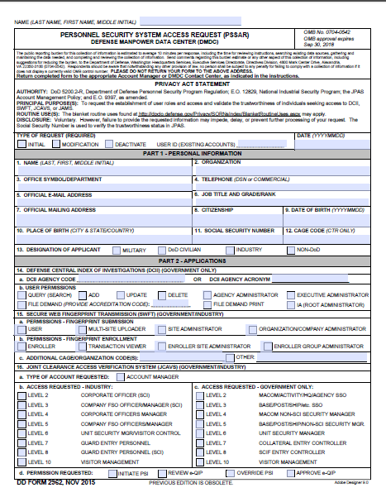
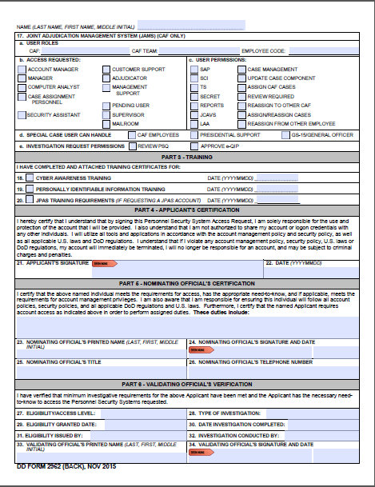
Personnel Security System Access Request (PSSAR)
(Required for JPAS, eQIP permissions, and SWFT)
Note: Completed PSSARs should be submitted to appropriate Account Manager or DMDC Contact Center as outlined in PSSAR Procedures. Page 3 of PSSAR provides detailed instructions for completion.

Slide 37
JPAS User Levels
LEVEL 2 SCI security personnel at unified command, DoD agency, military department or major command/equivalent headquarters. PSM Net is determined by the responsible SOIC or designee. (Read and Write Access - SSBI)
LEVEL 3 SCI security personnel at echelons subordinate to Level 2 at a particular geographic location (installation, base, post, naval vessel). PSM - Net is determined by the responsible SOIC or designee. (Read and Write Access-SSBI)
LEVEL 4 Non-SCI security personnel at unified command, DoD agency, military department or major command/equivalent headquarters. PSM - Net is determined by the responsible Security Officer or designee. (Read and Write Access - NACLC/T3/T3R/ANACI)
LEVEL 5 Non-SCI security personnel at echelons subordinate to Level 4 at a particular geographic location (installation, base, post, naval vessel). PSM - Net is determined by the responsible Security Officer or designee. (Read and Write Access - NACLC/ANACI/T3/T3R)
LEVEL 6 Unit security manager (additional duty) responsible for security functions as determined by responsible senior security official. (Read and Write Access - NACLC/T3/T3R/ANACI)
LEVEL 7 Non-SCI Entry control personnel. Individuals who grant access to installations, buildings, etc. Varies according to organizations. (Read Access - NACLC/T3/T3R/ANACI)
LEVEL 8 CI Entry control personnel. Individuals who grant access to SCIF installations, buildings, etc. Varies according to organizations. (Read Access - SSBI)
LEVEL 10 Visitor Management. Level 10 users will have the same view of the JCAVS Person Summary as a JCAVS Level 7 User. They will receive Visit Notifications when their SMO is being notified of a visit. A Level 10 User may not be an Account Manager, create or delete an account at any level

Slide 38
Common Misuses of JPAS
When you log in to JPAS and click the “I agree” button, you are consenting to the terms and use of the JPAS application. Please make note of some the misuses of JPAS:
Sharing of username, password, CAC, or PIV cards and/or associated PIN numbers to access the system.
Allowing non-cleared individuals to access the system.
Leaving the JPAS application unsecure while logged in.
Allowing others to view data on the JPAS screen that do not have the proper authorization.
Printing or taking a screenshot of JPAS data.
Note: See JPAS Account Management Policy Section 5.8 Misuse of JPAS.

Slide 39
Common Misuses of JPAS cont.
Querying the JPAS application for ‘celebrity’ records.
Querying the JPAS application for your own record.
Entering test or “dummy” SSNs into JPAS.
Entering false or inaccurate information into the system.
Initiating investigations for subjects who you have no owning/servicing relationship.
Querying the JPAS application for information you have no need to know to conduct your official duties.
Note: See JPAS Account Management Policy Section 5.8 Misuse of JPAS.

Slide 40
JPAS Account Activity
Why does my account keep getting locked or going away?
5.6 Account Activity
An active JPAS account is one that has been logged into within the past 30 days. An inactive JPAS account is an account that has not been logged into in over 30 days. If a JPAS account is inactive—i.e., not successfully accessed—for more than 30 days, the JPAS system shall automatically lock the account. The AM managing the account will be able to unlock the account, unless the account exceeds 45 days of inactivity. JPAS accounts that have not been logged into for longer than 45 days are deleted per DoD Regulations (CYBERCOM TASKORD 13-0641). If an account is needed, a new account will have to be established following the aforementioned guidelines.

Slide 41
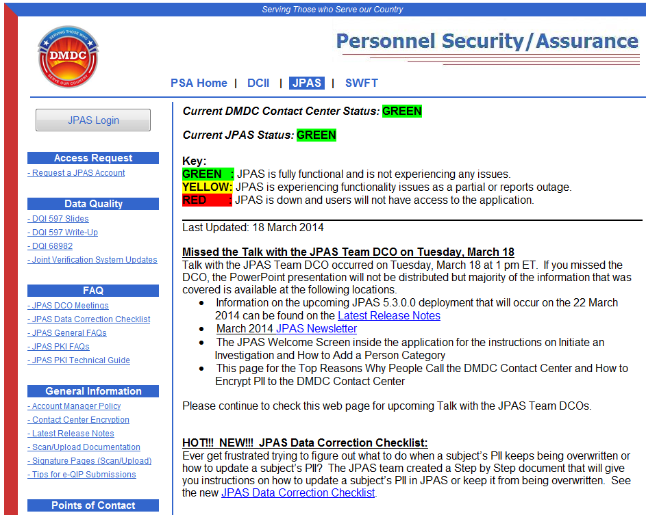
JPAS Home Page
This is the best page to bookmark: www.dmdc.osd.mil/psawebdocs
JPAS Status, Alerts, Notices, FAQs and general information, is posted here
If unable to log in via above link, try the following link that takes you to JPAS Disclosure page: https://jpasapp.dmdc.osd.mil/JPAS/JPASDisclosure
For Customer support:
DMDC Contact Center: 800-467-5526
DSS Call Center: 888-282-7682

Slide 43
Now That You’re In……

Slide 44
JPAS Basics
Person Categories
Within Industry, we will only create “Industry Tabs” (non-DoD) for our employees. Each employee should have an “Industry Tab” that is associated with the CAGE for which the employee is assigned.
A person can have more than one “active” industry tab (i.e., multiple companies).
A person can also have “other” tabs, i.e., Active Duty, National Guard, etc.

Slide 45
JPAS Basics
An Industry Tab is made up of three parts:
Person Category Title (Industry)
Person Type (Contractor, Consultant, or Key Management Personnel)
Contractor and Consultant categories are updated by the Facility Security Officer
Key Management Personnel (KMP) are updated through the e-FCL.
As of January 19, 2010, all companies in process for a facility clearance or reporting a changed condition will be required to use the DSS Electronic Facility Clearance (e-FCL) online application to submit their documents to DSS. This information includes: the SF 328, list of key management personnel, list of stockholders, articles, bylaws, and other supporting documentation.
Organization (CAGE-I) (I indicates this is an Industry tab)

Slide 46
JPAS Basics
Owning and Servicing Relationships
Relationships: Within JPAS, you must establish a “relationship” with everyone within your SMO before you can do anything to their record, i.e., indoctrinate, debrief, separate, submit RRU, initiate Investigation, etc.
There are two types of Relationships:
Owning: If you are responsible for maintaining a person’s eligibility status and submitting their investigation request, you should own them. The assigned organization is usually the one that owns the records.
Servicing: If you need to be notified of a change in a person’s eligibility status or if you need to update their record, you should service them.
Note: You can establish a one day relationship by entering same in and out date when you in-process. That relationship will go away at midnight EST.
Only modify Person Category Tabs and relationships that are associated with YOUR company.

Slide 47
JPAS Basics
RRU- Research, Recertify, and Upgrade Requests (July 2016)
Reciprocity: PSMO-I will attempt to verify the eligibility via Scattered Castles / CVS prior to contacting the agency directly. If the eligibility is not verified in the available databases, a hardcopy reciprocity request will be submitted to the appropriate agency. Timeframes will vary depending on the action needed or agency response.
Upgrade: Official government requests for information from DoD CAF, DOHA or DSS
Recertify: The FSO has reason to believe the eligibility line in JPAS is incorrect. All other personnel security related questions should be directed to the DSS Knowledge Center at (888) 282-7682.

Slide 48
JPAS Basics
RRU- Research, Recertify, and Upgrade Requests (July 2016) cont.
Separation from the company: Upon separation from the organization, the FSO enters a separated date for the employee in the system. If an investigation is open for the employee, a notification will be forwarded to the appropriate CAF to determine whether the investigation needs to be cancelled. Notify PSMO-I via Research request when a separation occurs and either of the following two items exist. Notification will permit PSMO-I to take appropriate actions on the record.
An action is pending on a person, e.g. pending incident report, pending adjudication and pending investigation request.
There is not an open investigation and an interim eligibility exists.

Slide 49
The Person Data Repository (PDR)
Why does Personal Information continue to change in JPAS each month:
As of March 2015 many JPAS Industry Persons were added to the DoD Person Data Repository.
As a result Industry FSOs will not be able to manually update data for those subjects directly in JPAS.
Person data from the PDR will overwrite whatever is changed in the JPAS database once per month on the day of the subject’s birth. To make corrections FSOs will now need to follow PDR data update instructions located on the JPAS PSA WebPage.
Hint: Look for the Electronic Data Interface Person Identifier (EDIPN).

Slide 50
Retaining PCL Documentation
NISPOM 2-202a
The FSO shall inform the employee, in writing, that the SF86 is subject to review solely to determine its adequacy and ensure necessary information has not been omitted. The FSO shall not share information from the SF86 for anything other than to determine its adequacy and ensure necessary information has not been omitted
NISPOM 2-202b
The FSO shall ensure that the applicants fingerprints are authentic, legible and complete to avoid delays. The FSO shall retain the original signed SF86 and releases until the clearance process is complete. This documentation must be kept confidentially and only until the eligibility is granted.

Slide 51
Retaining PCL Documentation cont.
The Following Clarification is posted to the DSS Website:
Obtain a Copy of Previously Filled out Standard Form 86 in e-QIP.
With the requirement to maintain a copy of the SF-86 until the investigation is complete, OPM has improved their technology and created the ability to gain access to this document at any time without the need to maintain the hard copy on file. DSS will no longer be reviewing these documents as part of their assessments. FSO’s can initiate the subject in e-QIP and upon logging in, the subject will have the option to view their previous document as shown below.

Slide 52
JPAS Notifications
Notifications should be checked often
Eligibility Change
Incident Updates
Investigation Request Status
Message from CAF
RRU Response
Action by Servicing SMO
Visits (remain for duration of visit) or until manually removed
Notifications are removed:
30 days from receipt of notification (except for visits)
Manually, if you click on “Remove from Display” checkbox

Slide 53
JPAS Reports
Act PC-Access/No PSM Net
Lists organizations that have a Person Category for a subject without a PSM Net relationship owned or serviced
Inv Rqst by Duty Pos
This report indicates all Investigation Requests currently in your PSM Net by Duty Position.
Non-SCI Totals
List of all Non-SCI Access’s, for owned and or serviced Person Categories in your PSM Net or subordinate organization.
Periodic Reinvest
List of Personnel within your PSM Net or subordinate organization whose investigation may be out-of-scope and may require a Periodic Reinvestigation

Slide 54
JPAS Reports cont.
Personnel
Detailed list of Personnel in your PSM Net and or subordinate organization, including access, eligibility and investigation information.
PSM Net Personnel
Abbreviated list of all personnel in your PSM Net or subordinate organization.
SMO-No PSM Net
Retrieve information regarding SMOs in your hierarchy that have not established a PSM Net.
SMO-No Users
Retrieve information regarding SMOs in your hierarchy that have established their SMO but have no Personnel with an Owning or Servicing relationship in their PSM Net.

Slide 55
JPAS Reports cont.
SMO-PC-No Access
Retrieve information regarding SMOs in your hierarchy that have established their PSM Net but don’t have an access indoctrinated for a Person Category.
Suspense
Retrieves information regarding Suspense information the JCAVS user created from a subject’s Person Summery screen / Suspense Data link.
Suspensions
Information regarding Suspensions (eligibility and/or Access) for personnel in your PSM Net and or subordinate organization.

Slide 56
Break In Employment vs. Break In Access
Break in employment is the point when a cleared contractor terminates the employment of an employee with eligibility for access to classified information regardless of the reason for the termination, and regardless of whether the termination was initiated by the company, the employee (e.g., by resignation), or by mutual agreement of the company and the employee.
When a contractor terminates the employment of an employee who is eligible for access to classified information at the time of termination, the contractor must complete the following actions in JPAS:
“Debrief” the employee from access (Note: this is the verbiage in JPAS for removing access)
Add a separation date to the record
Out-process the employee’s eligibility record from the PSM Net

Slide 57
Break In Employment vs. Break In Access Cont.
Break in Access – When a cleared employee no longer has a requirement to access classified information and there is no reasonable expectation they will require access in the future
Debrief, Separate, Out-process
Contractors should continue to submit adverse information reports as long as the employee has eligibility
Annual security refresher training is NOT required

Slide 58
Break In Employment vs. Break In Access Cont.
Break in Access – When a cleared employee no longer has a requirement to access classified information but there is a reasonable expectation they will require access in the future
Debrief from access, maintain owning relationship until a separation action is necessary
Contractors should continue to submit adverse information reports as long as the employee has eligibility
Annual security refresher training is required

Slide 59
Contact Information
DMDC Contact Center:
8:00 am – 8:00 pm ET, M-F
Contact Information
1-800-467-5526
dodhra.knox.dmdc.mbx.contact-center@mail.mil
dmdc.swft@mail.mil
Menu Options:
1 – JPAS
2 – e-QIP (Non-Industry)
3 – SWFT
4 – DCII
5 – Personnel Security Inquiry
6 – General Inquiry / Contact Center Information
DSS Knowledge Center:
Contact Information
1-888-282-7682
call.center@dsshelp.org
Menu Options:
1 - Account Lockouts and Passwords- 8:00AM to 6:00PM ET
2 - Personnel Security Inquiries to include e-QIP - 8:00AM to 5:00PM ET
3 - Facility Clearance Inquiries - 8:00AM to 5:00PM ET
4 - OBMS
5 - STEPP/CDSE - 8:00AM - 4:00PM ET
6 - Industrial Policy International - After hours information regarding NISP Policy and International issues: http://www.dss.mil/isp/policy_programs.html
7 - Industrial Policy –After hours information regarding NISP Policy and International issues: http://www.dss.mil/isp/policy_programs.html
DoD CAF Call Center:
Contact Information
301-833-3850
SSOs and FSOs ONLY
Menu Options:
5 – Industry
PSMO-I Customer Service:
Email/Online received via mailbox at:
AskPSMO-I@dss.mil

